Slide 1
Build Your First IOS App With Swift
View iOS Development course details at www.edureka.co/ios-development
For Queries:
Post on Twitter @edurekaIN: #askEdureka
Post on Facebook /edurekaIN
For more details please contact us:
US : 1800 275 9730 (toll free)
INDIA : +91 88808 62004
Email Us : webinars@edureka.co

Slide 2
Objectives
At the end of this module, you will be able to:
Why Swift Programming ?
Comparing Swift With Others
Swift Features
Demo on iOS Swift

Slide 3
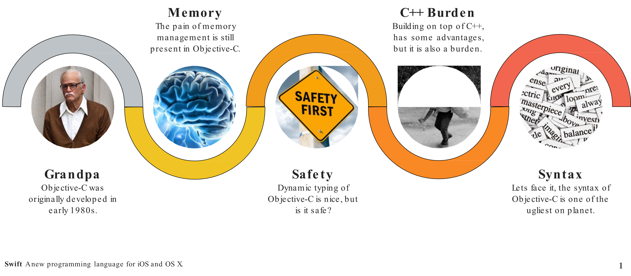
Why Swift ?

Slide 4
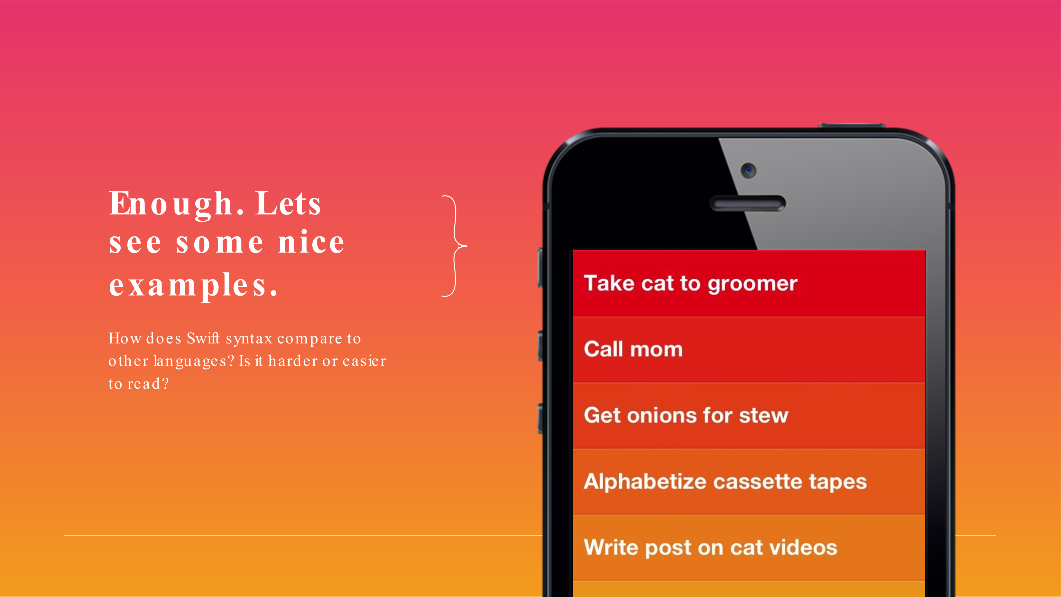

Slide 5
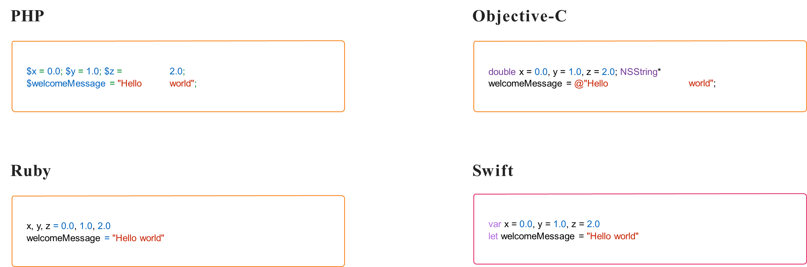
Variables

Slide 6
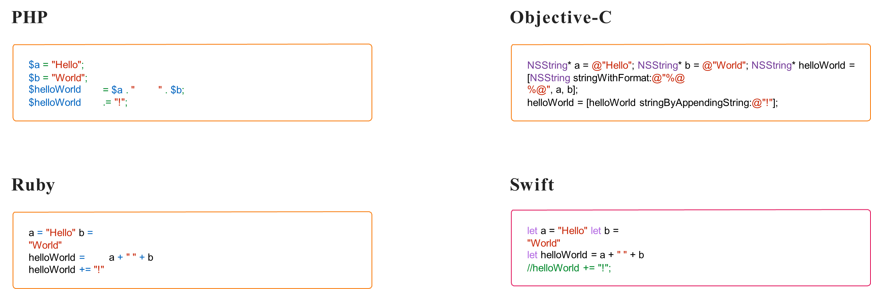
String Operations

Slide 7
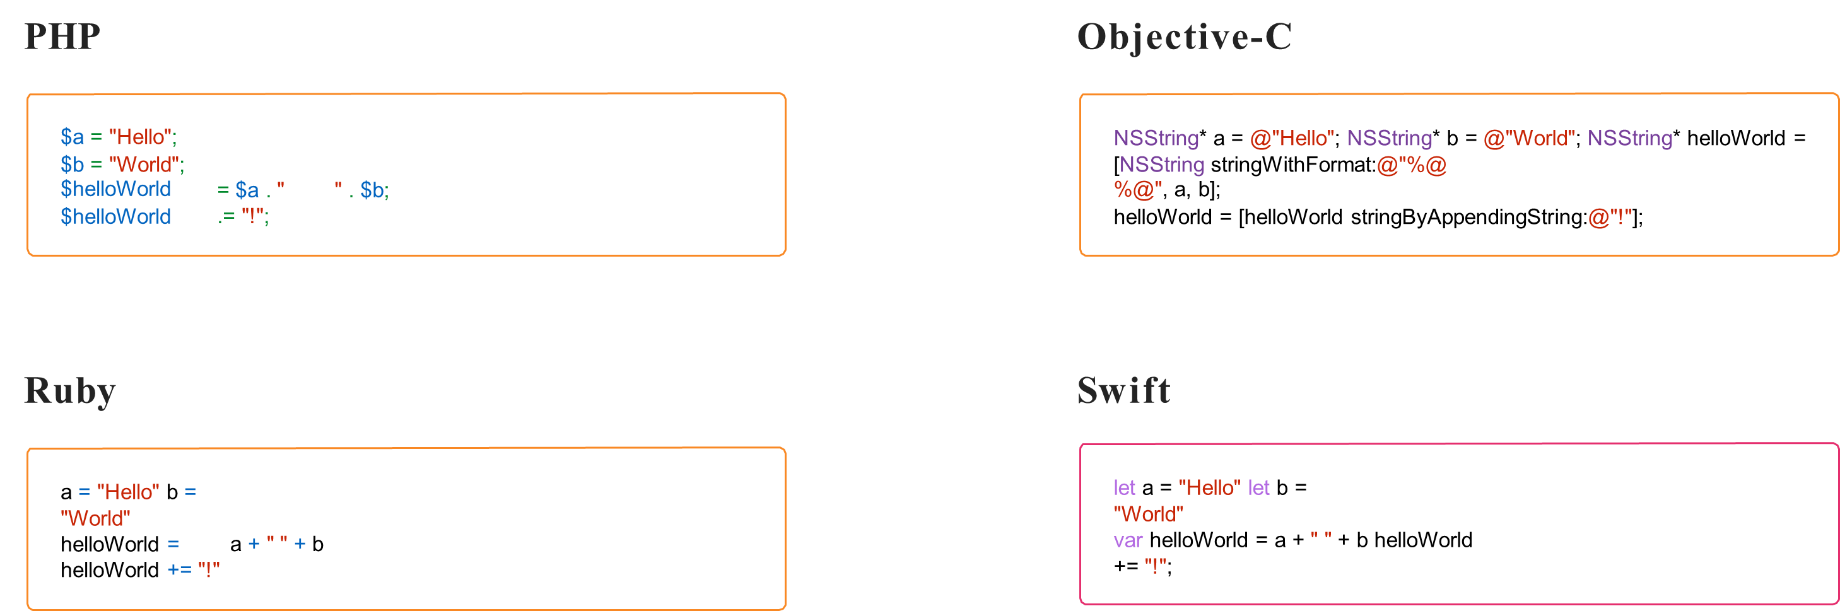
String Operations

Slide 8
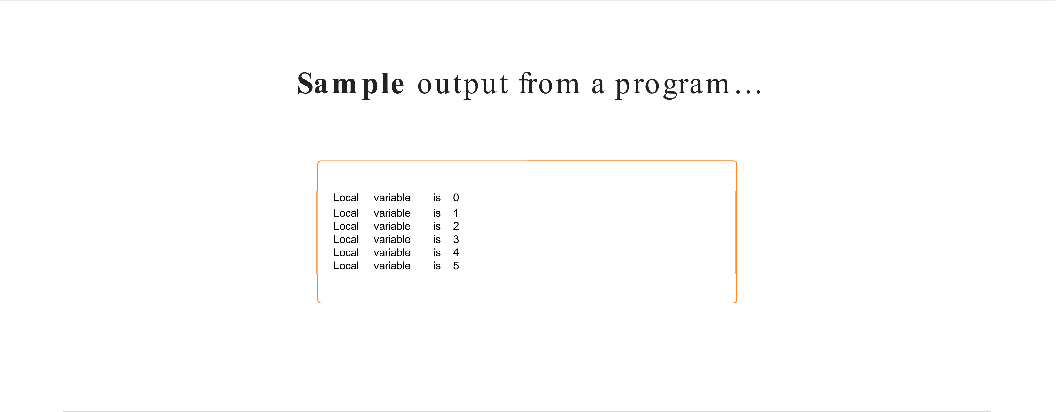
Loops

Slide 9
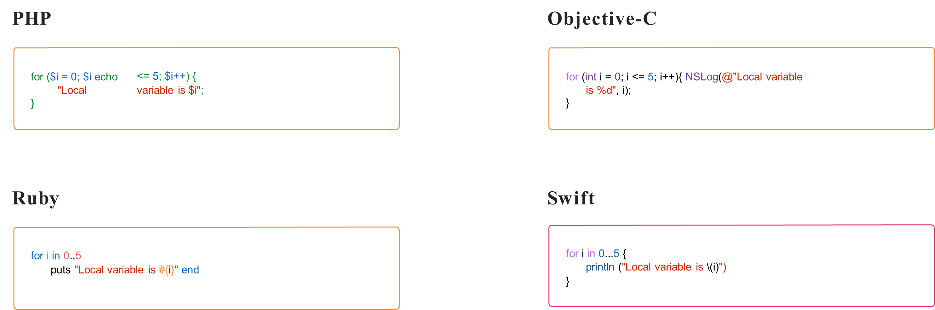
For Loop

Slide 10
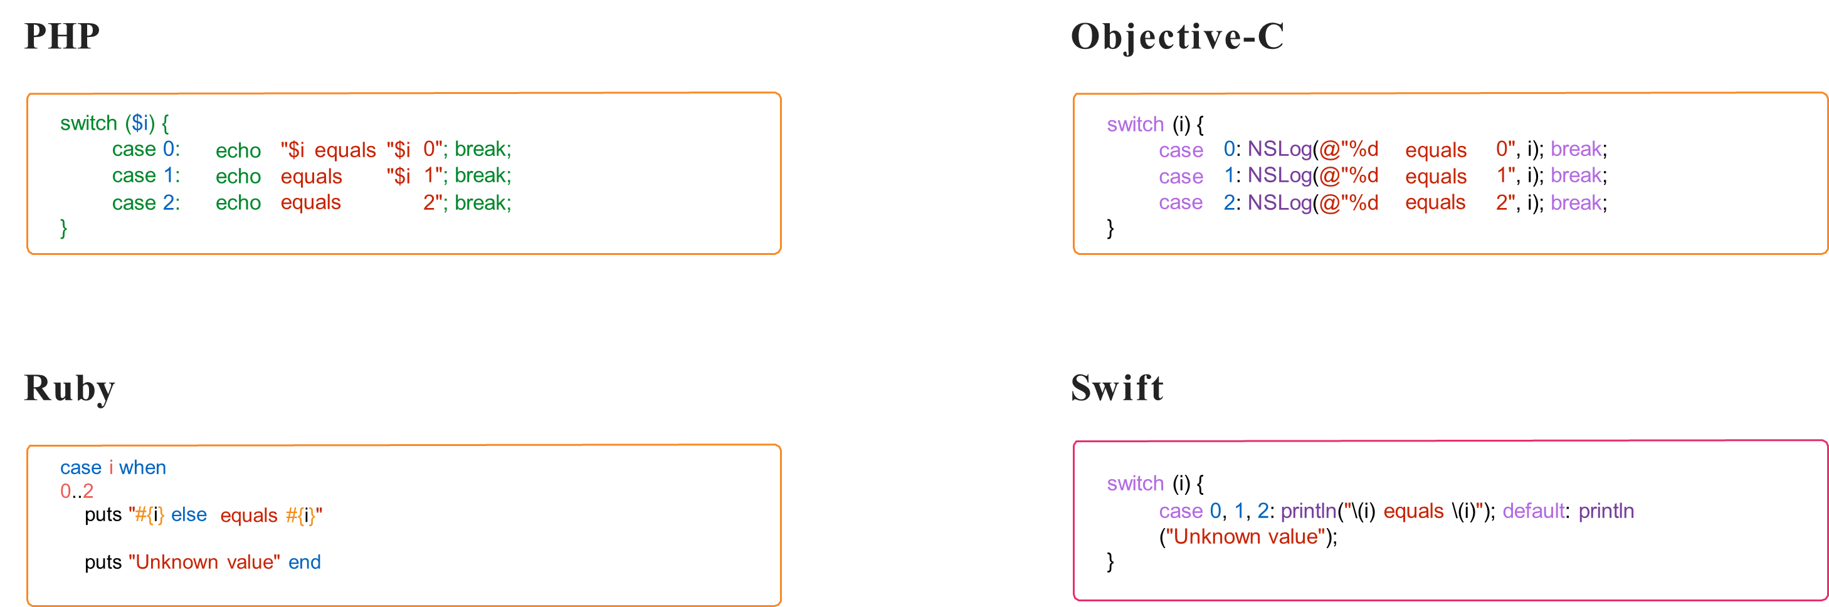
Switch

Slide 11

Functions

Slide 12
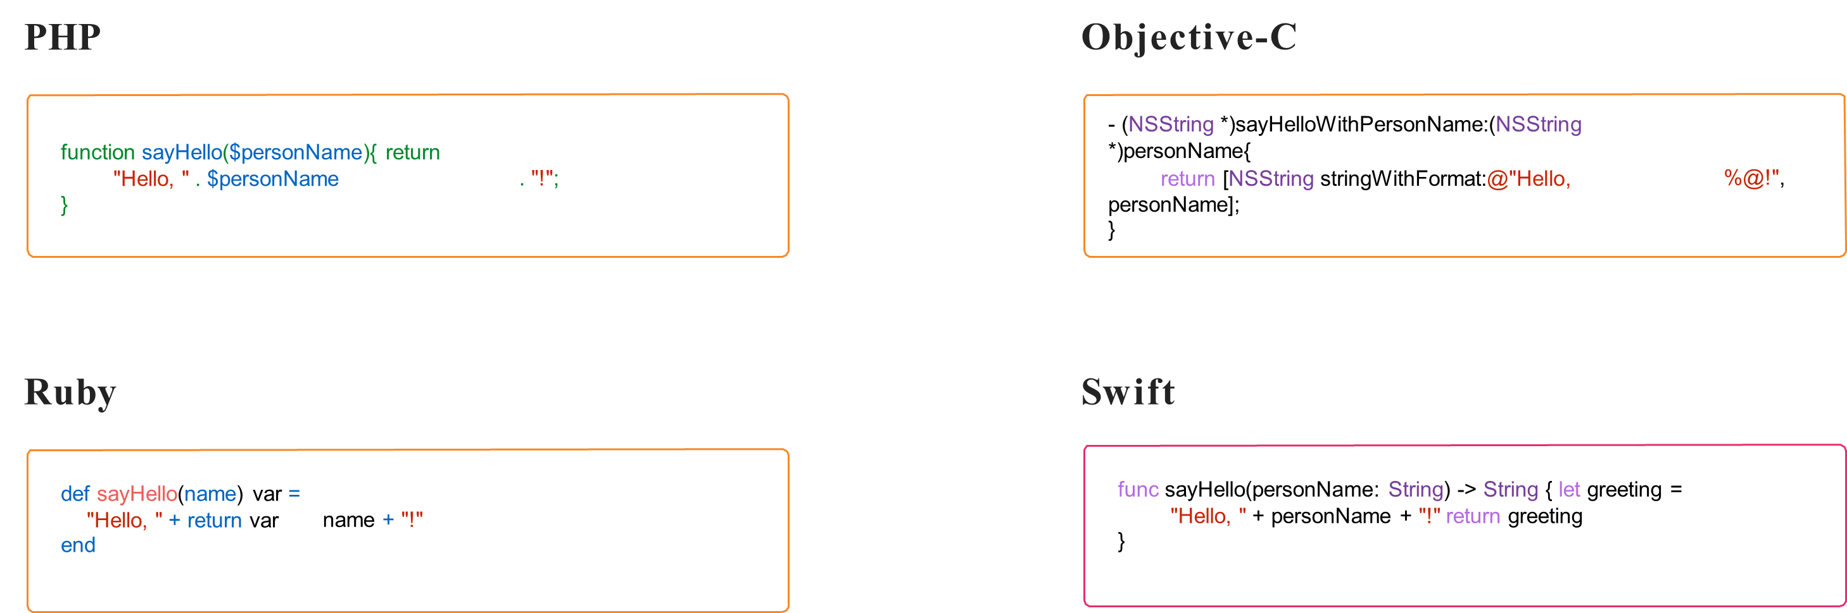
Functions

Slide 13
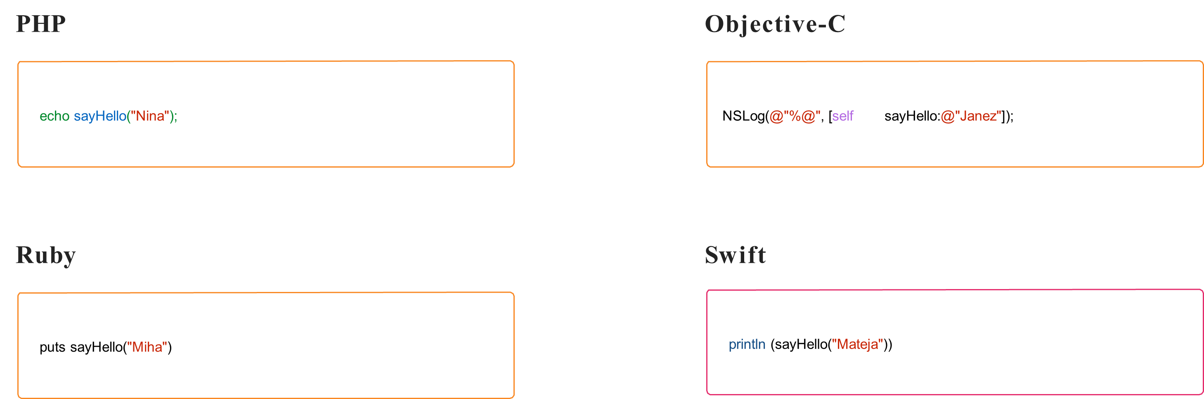
Functions

Slide 14
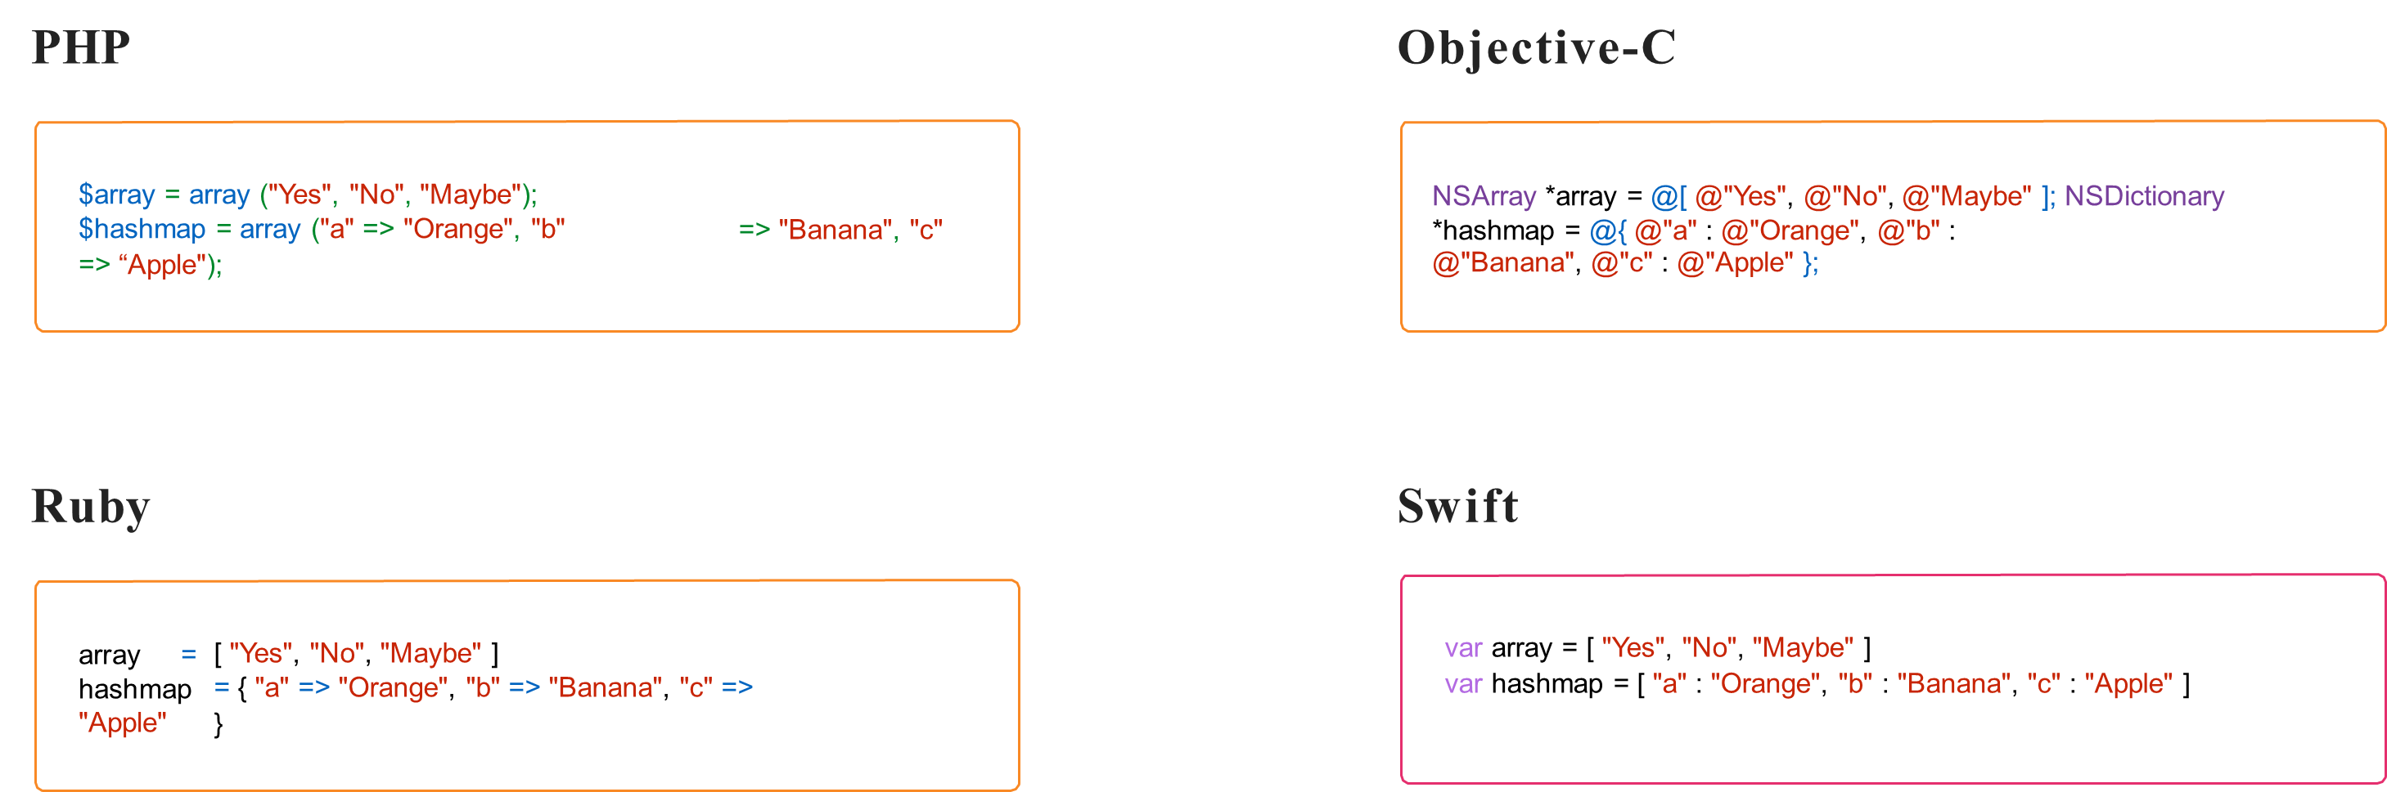
Collections

Slide 15
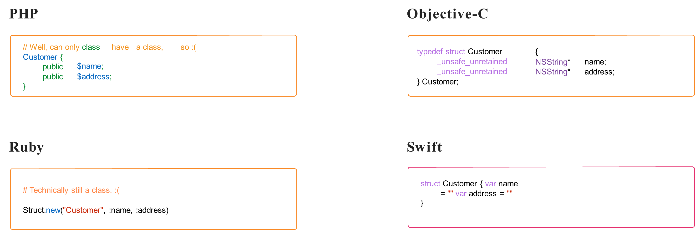
Structures

Slide 16
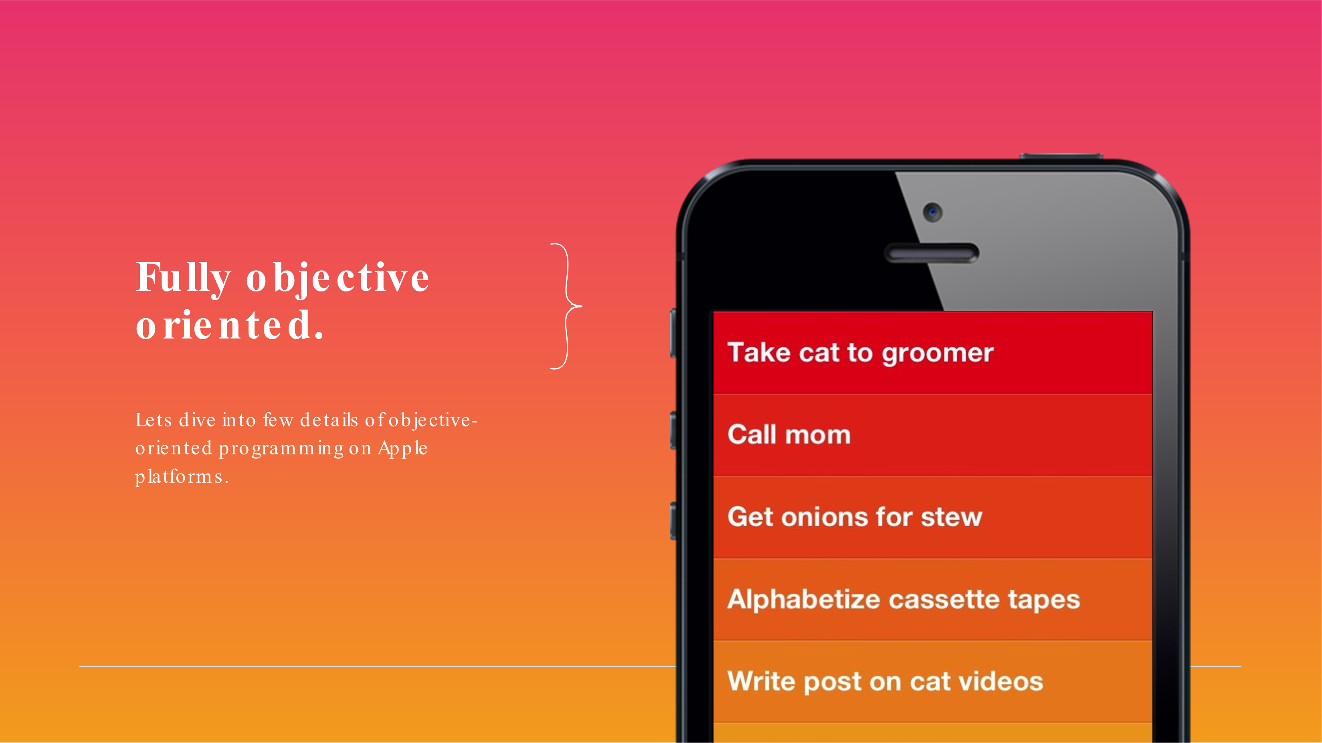

Slide 17
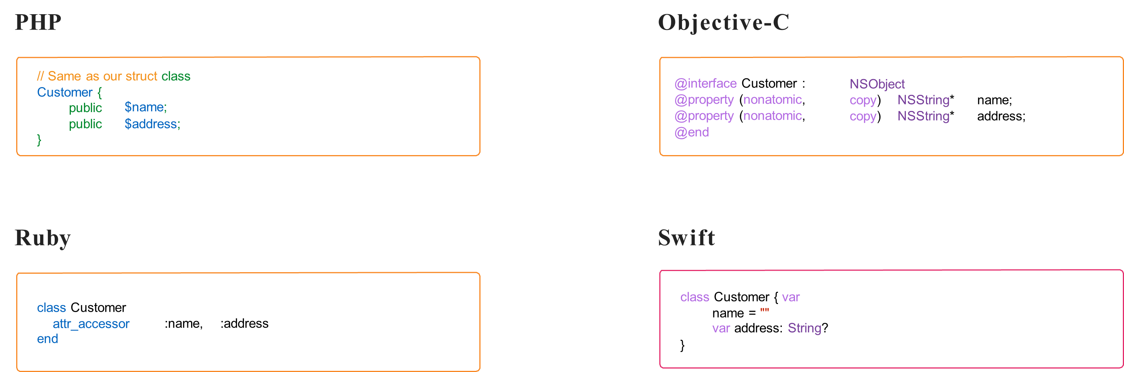
Classes

Slide 18
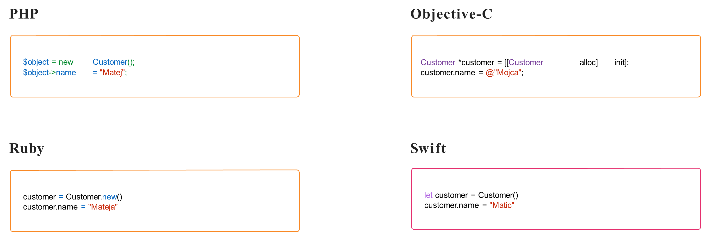
Initializations

Slide 19
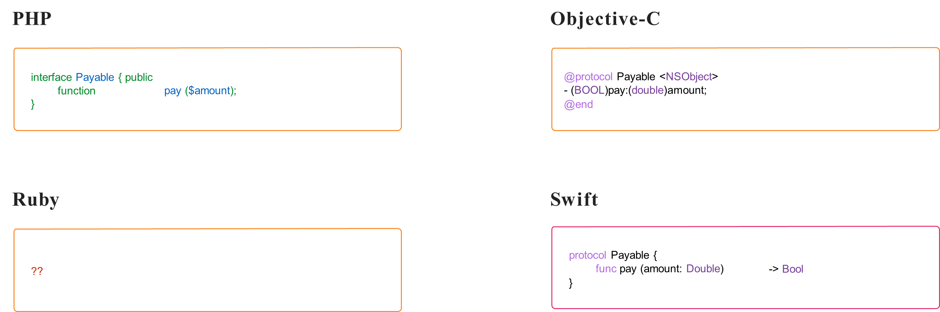
Protocols

Slide 20
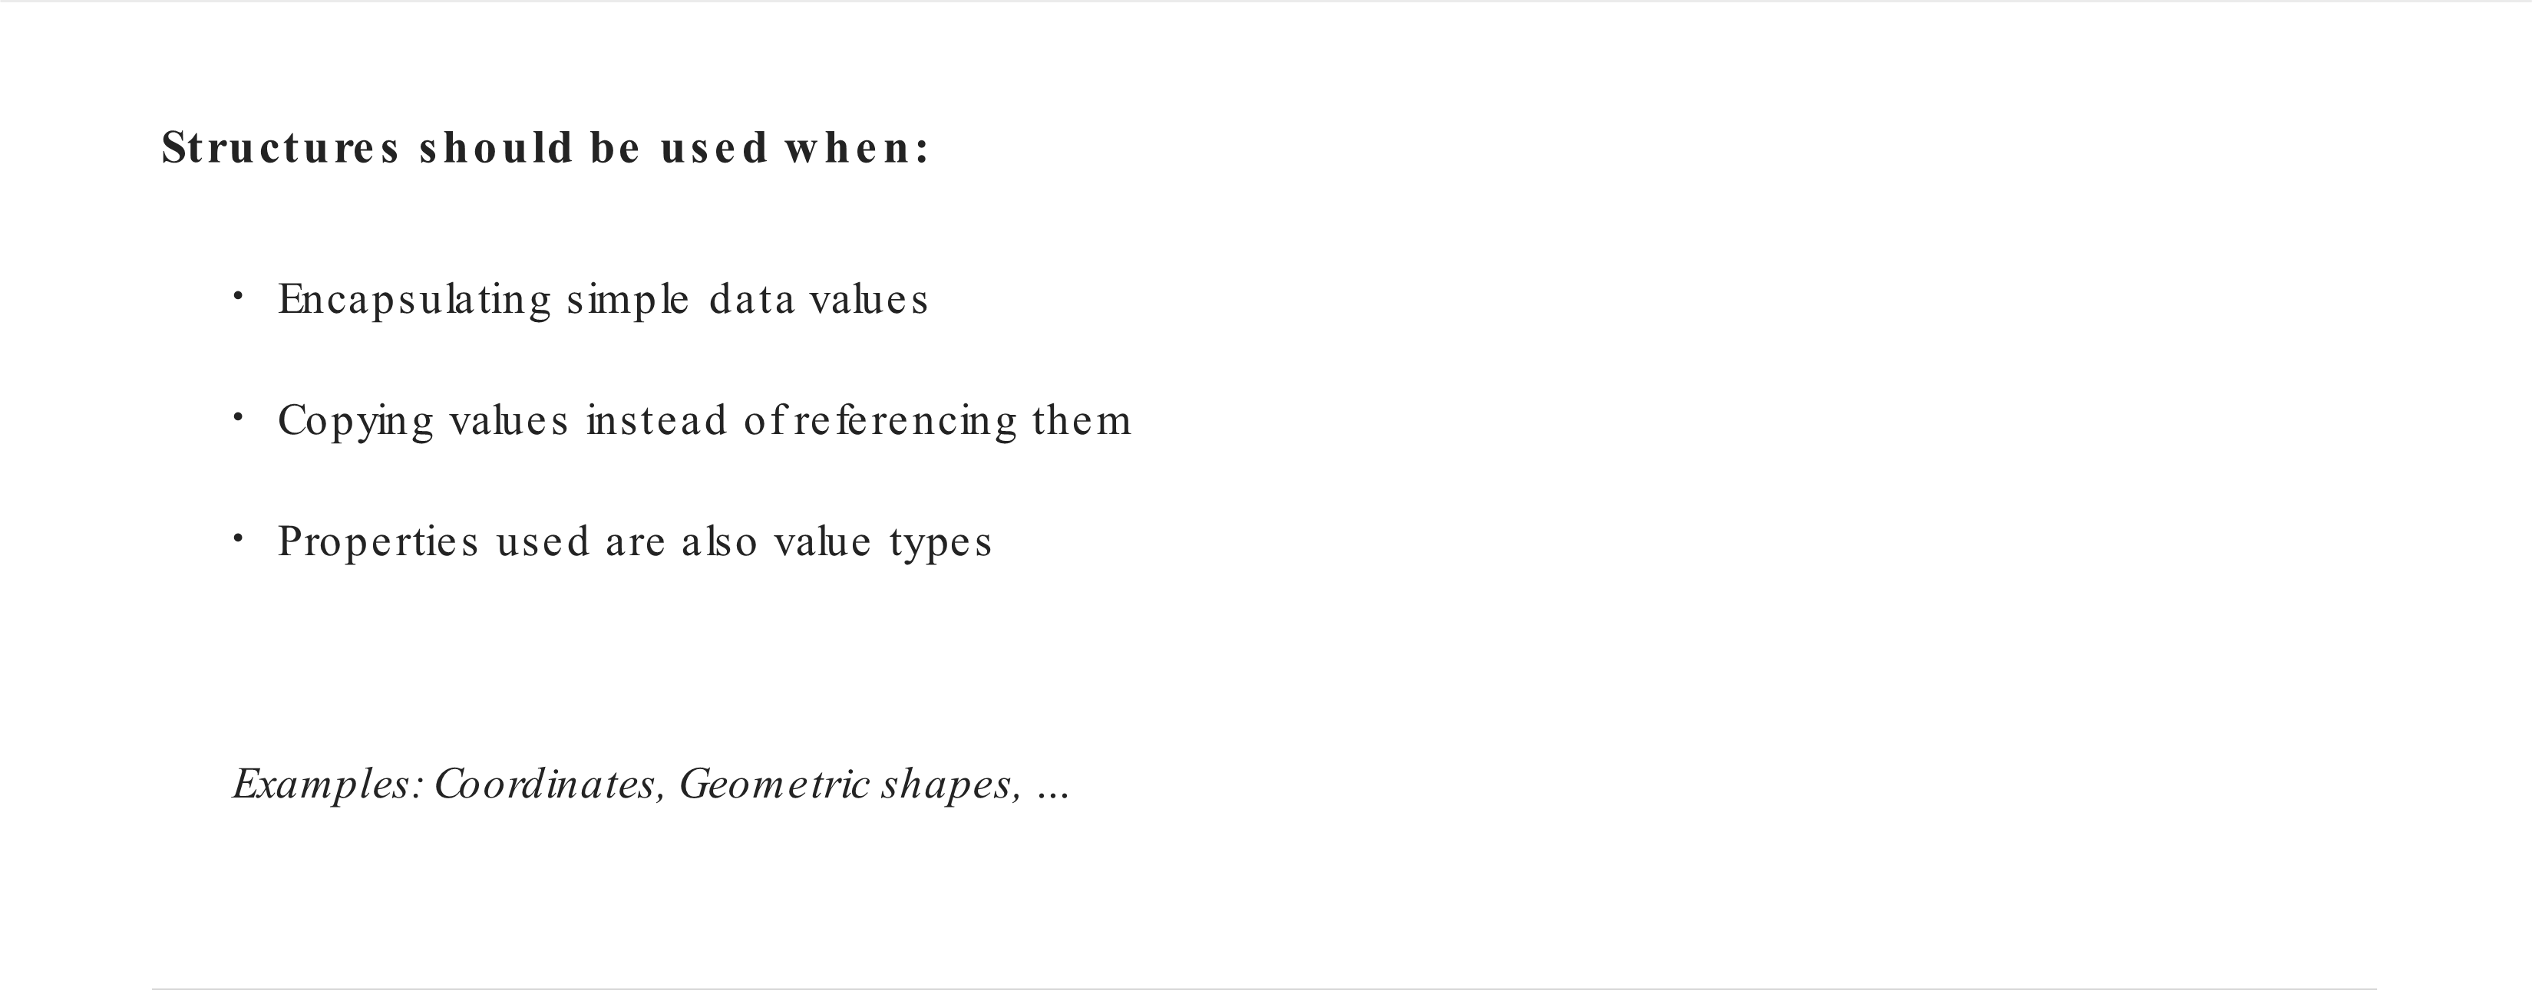
Structures or Classes

Slide 21
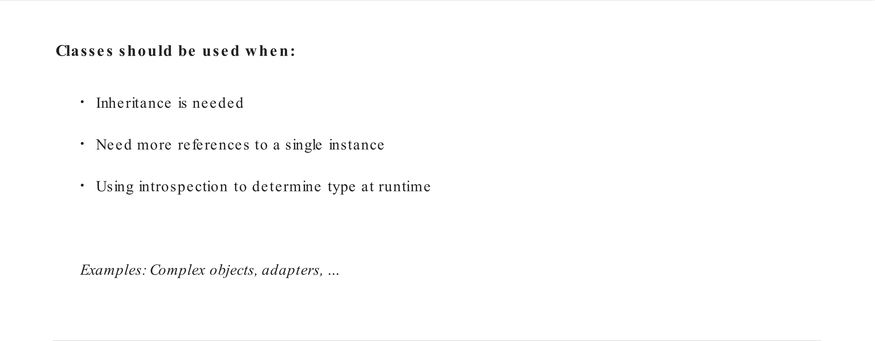
Structures or Classes

Slide 22
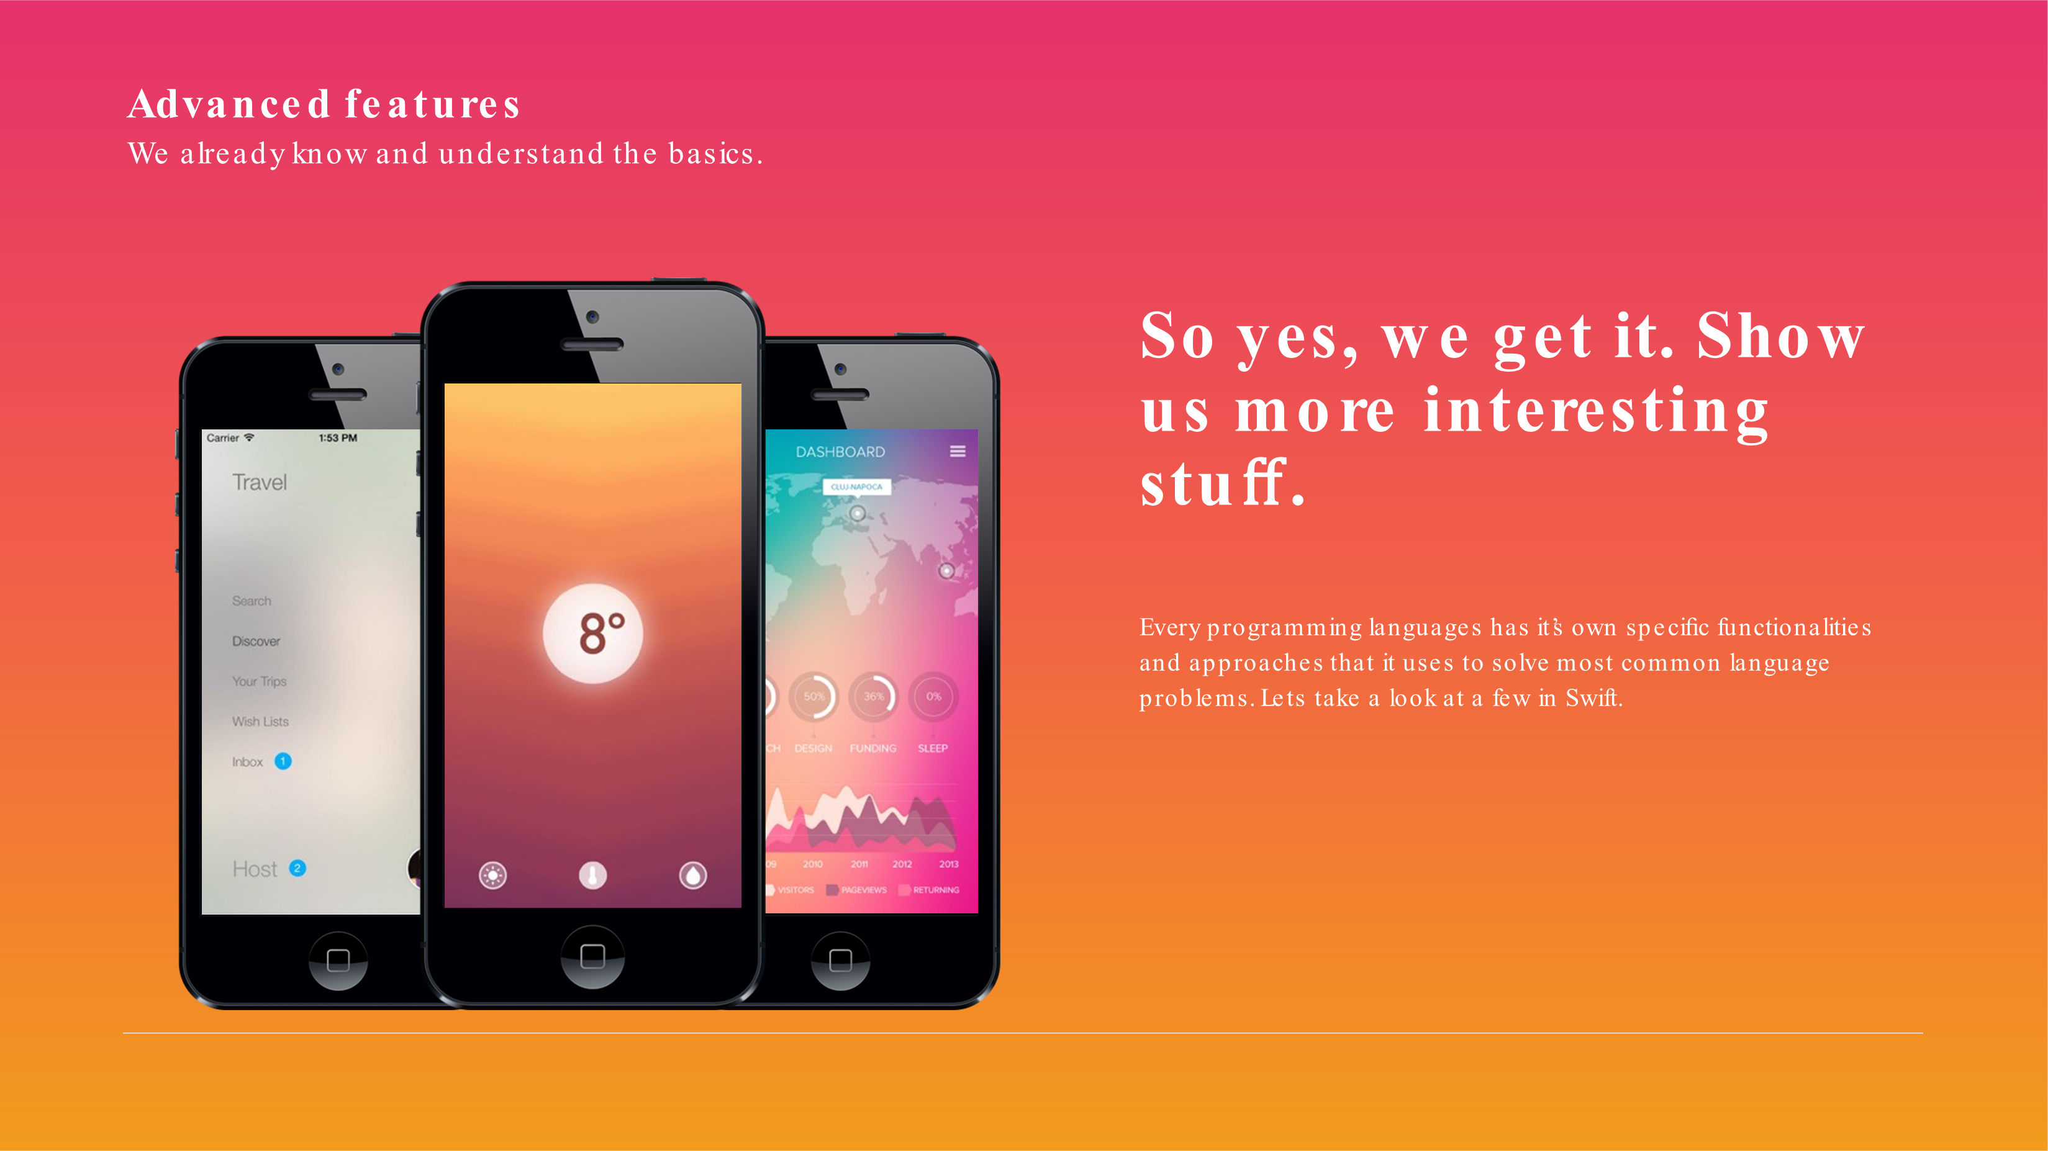

Slide 23
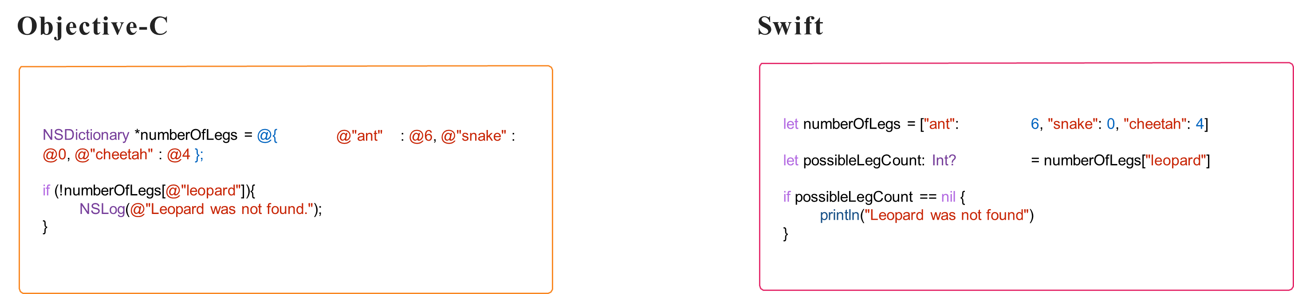
Optionals

Slide 24
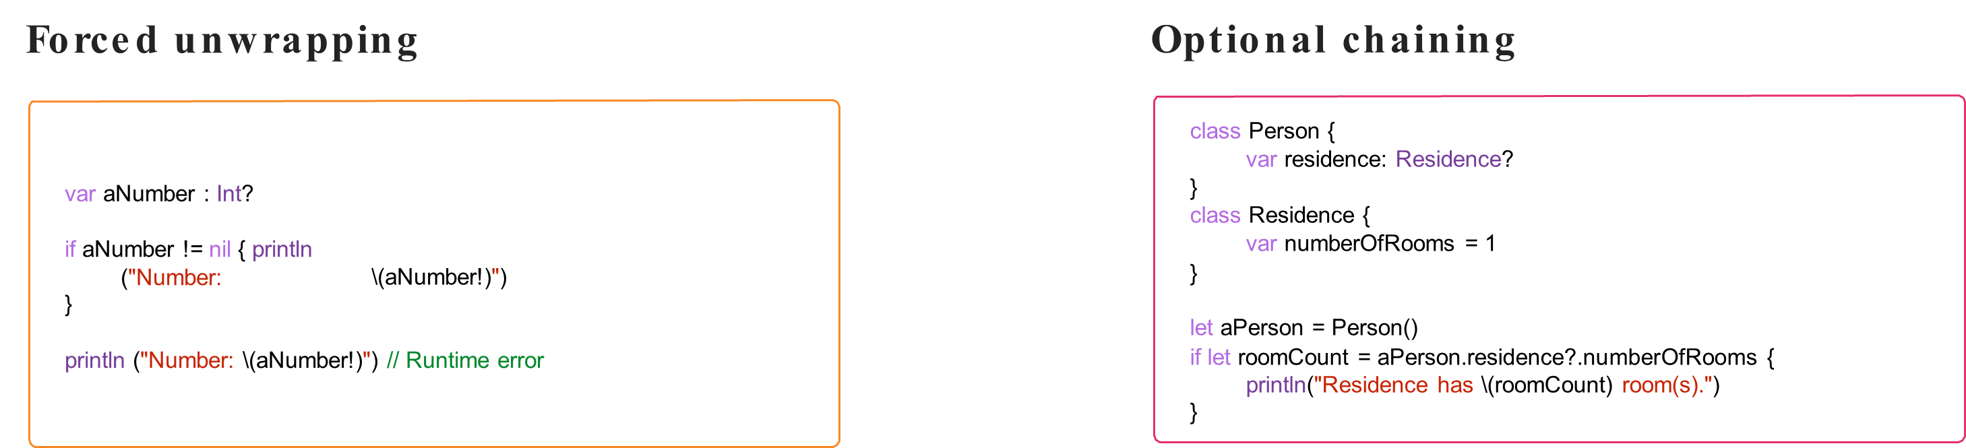
Unwrapping

Slide 25
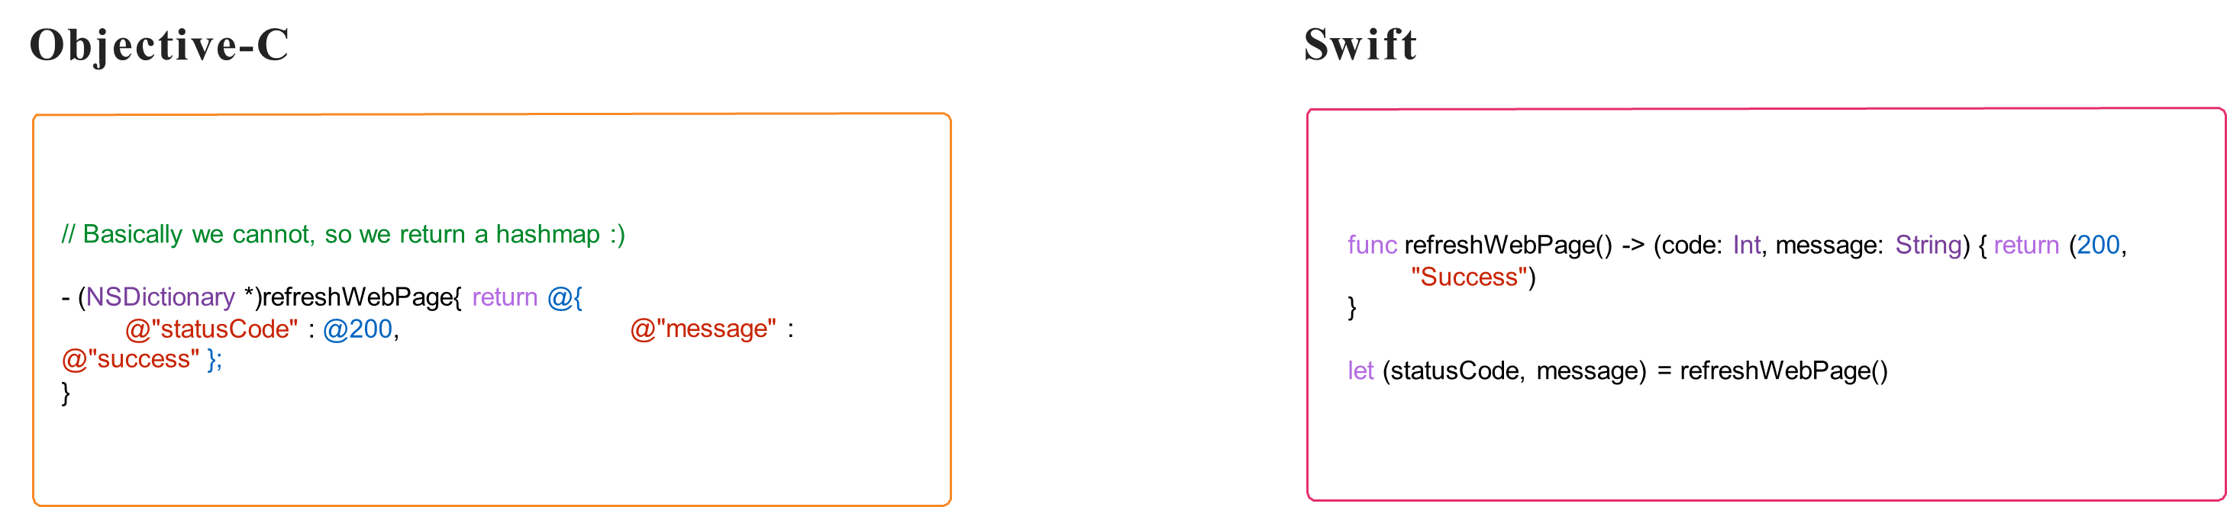
Tuples

Slide 26
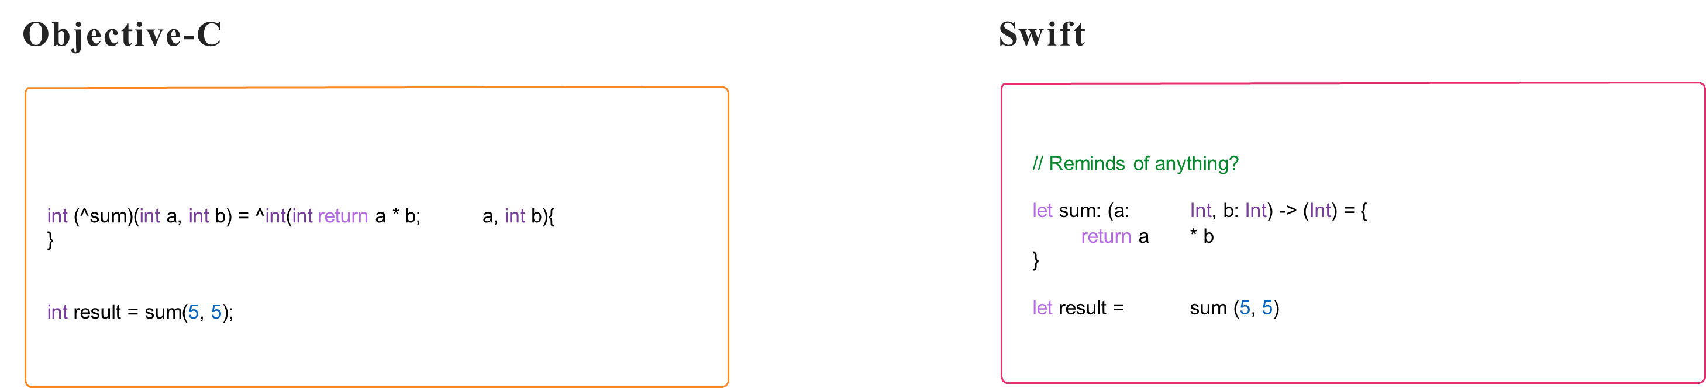
Closures

Slide 27
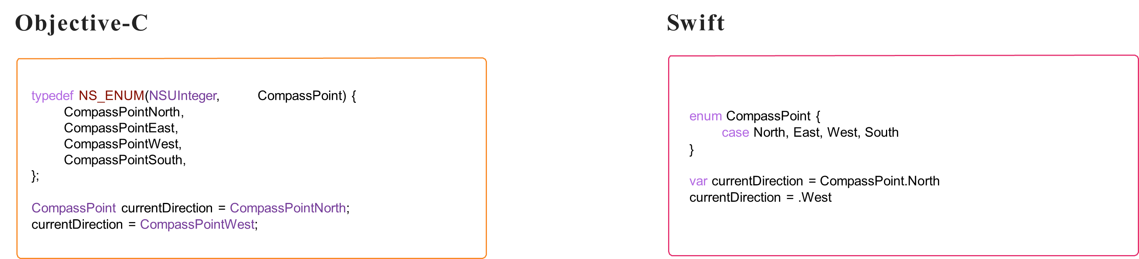
Enumerations

Slide 28
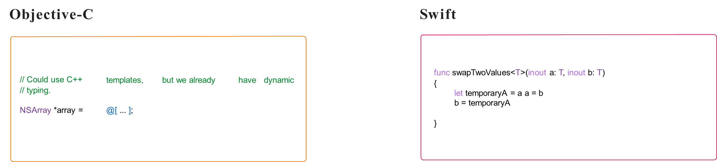
Generics

Slide 29
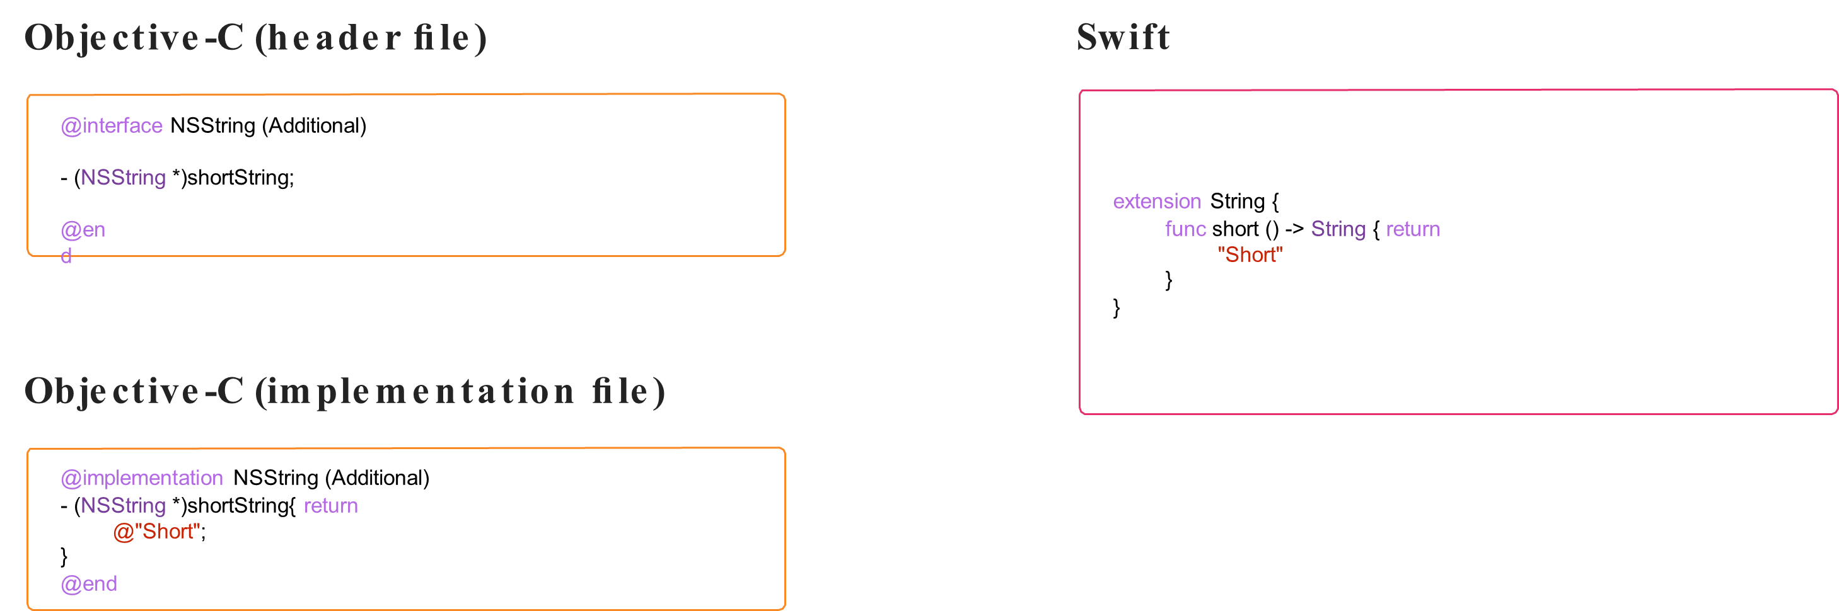
Extensions

Slide 30
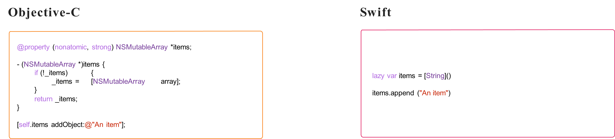
Lazy Instantiation

Slide 31
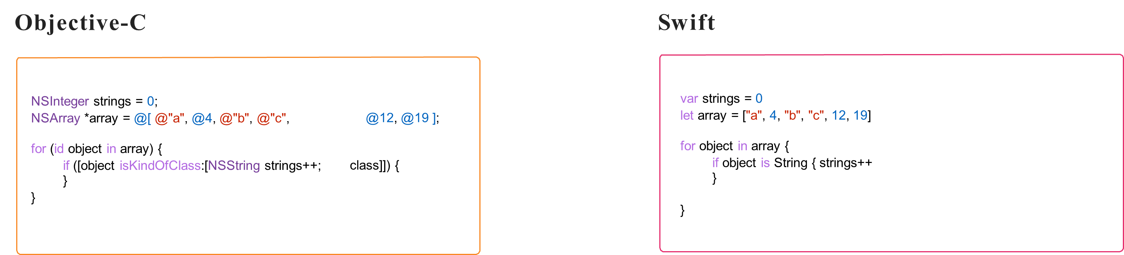
Type Casting

Slide 32
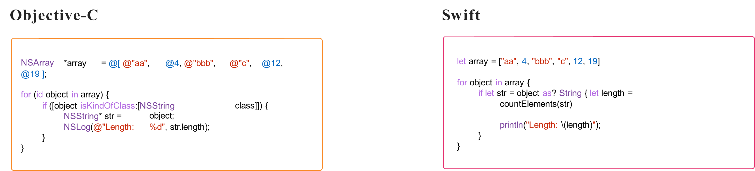
Type Casting

Slide 33
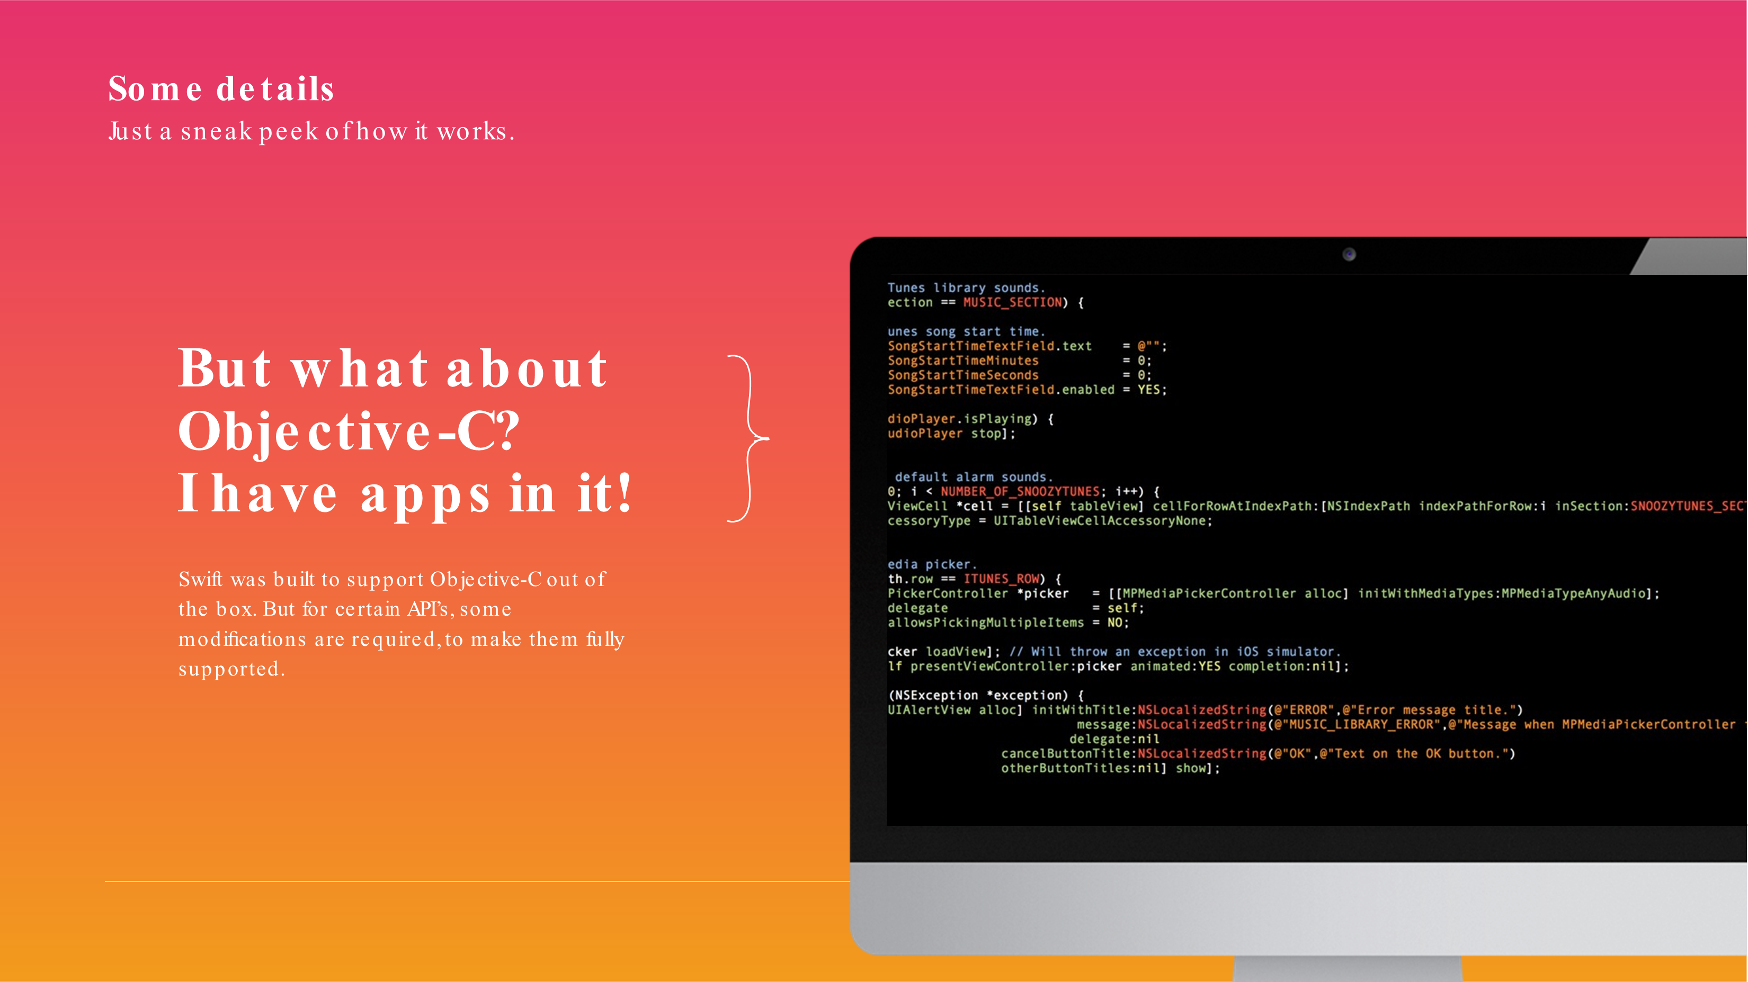

Slide 34
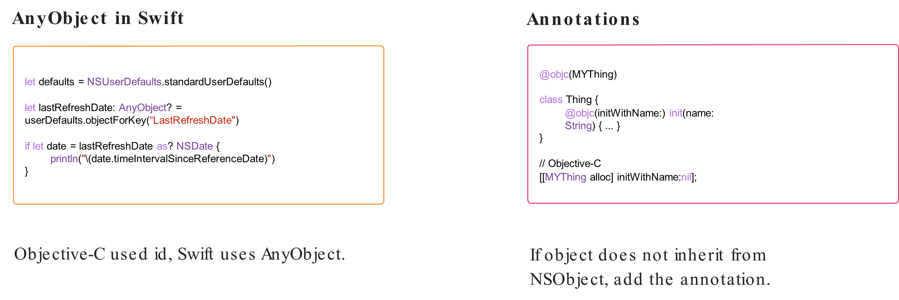
Interoperability

Slide 35
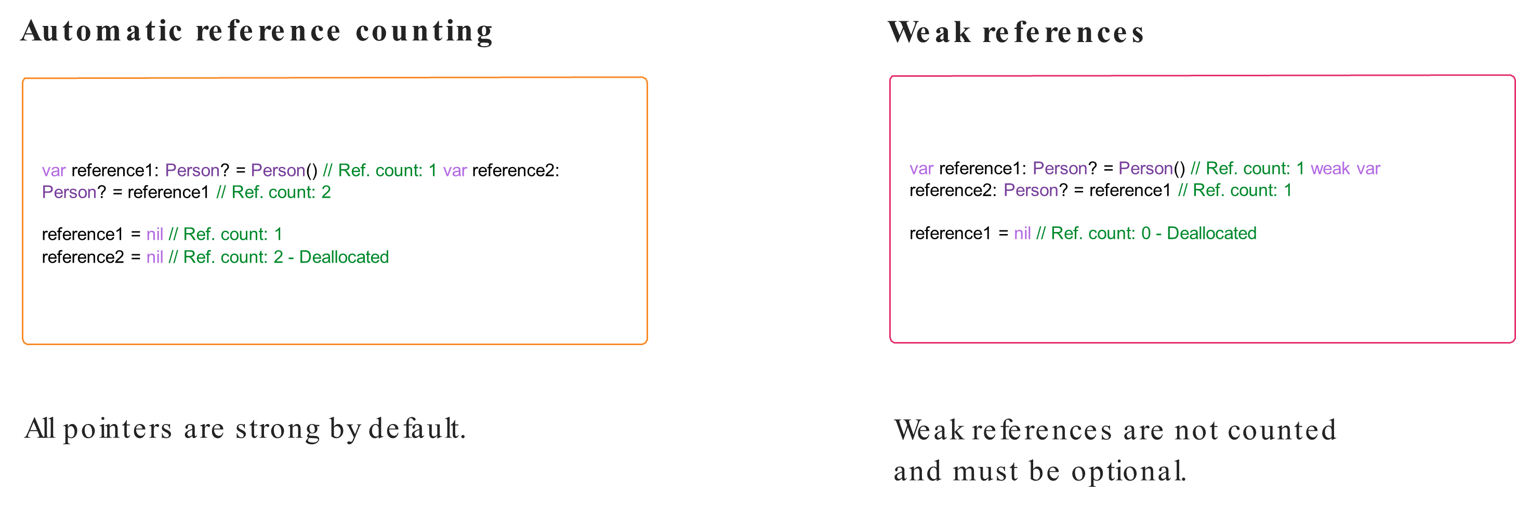
Memory Management

Slide 36
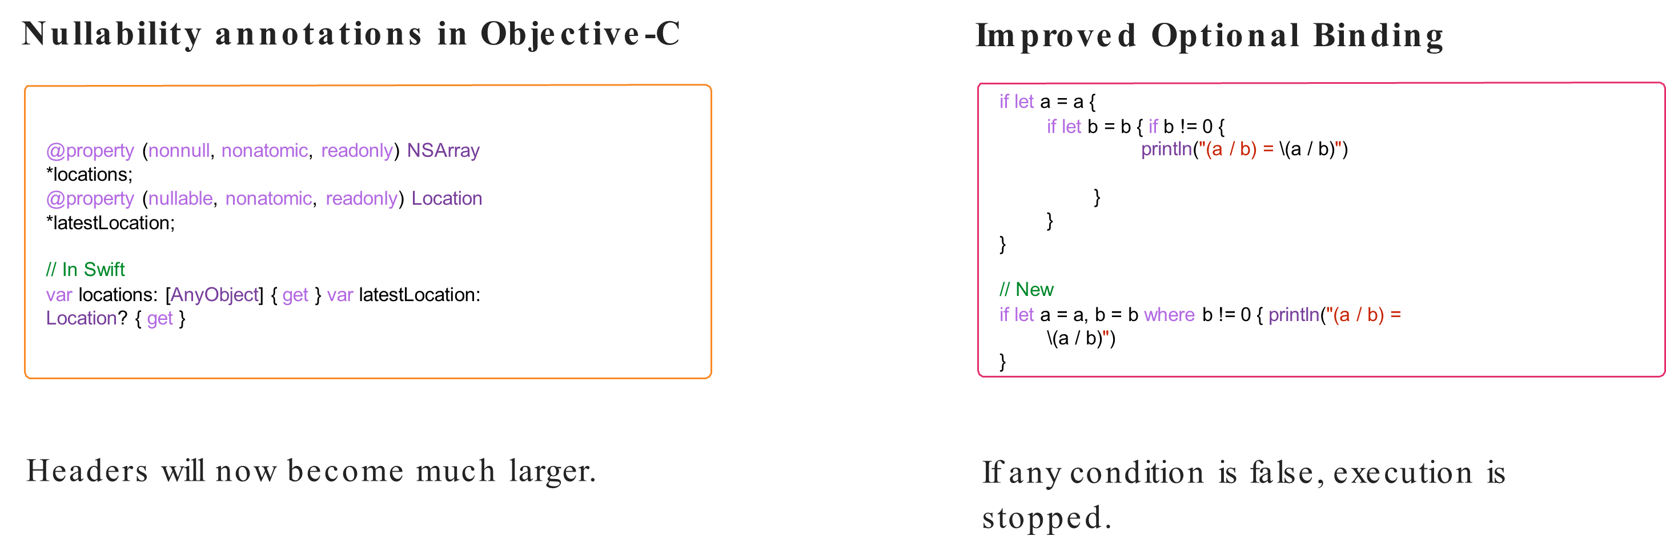
Tuples

Slide 37
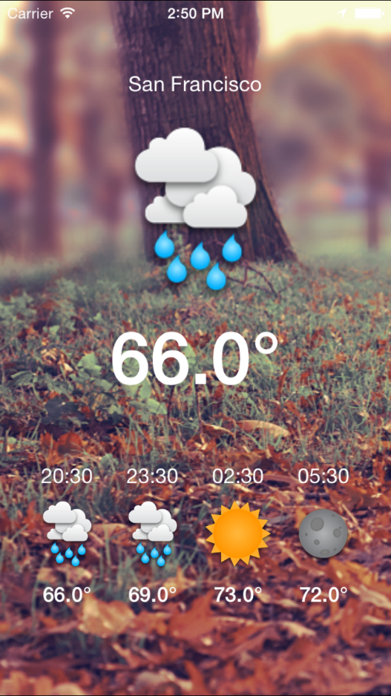
Building An iOS App In Swift
The application fetches users current location and displays appropriate Weather Information for next 3 hours
Application uses Alamofire networking library to perform network operations and received JSON response is parsed using SwiftyJSON Library.

